Slide 1
Software Testing and Quality Assurance
Week – 10

Slide 2
Agenda (Next Few Lectures)
Review
From integration testing to system testing
Ingredients of system testing
System Testing Techniques
Scenario-based testing

Slide 3
SCENARIO-BASED TESTING

Slide 4
What is a scenario
A scenario is a hypothetical story, used to help a person think through a complex problem or system.
"Scenarios" gained popularity in military
planning in the United States in the 1950's.
Scenario-based planning gained wide commercial popularity after a spectacular success at Royal Dutch/Shell in the early 1970's.
The Art of Strategic Conversation by Kees van der Heijden, Royal
Dutch/Shell’s former head of scenario planning.

Slide 5
What is a scenario based test case
The test is based on a story about how the program is used, including information about the motivations of the people involved.
The story is motivating. A stakeholder with influence would push to fix a program that
failed this test. (Anyone affected by a program is a stakeholder. A person who can influence development decisions is a stakeholder with influence.)

Slide 6
What is a scenario based test case
The story is credible. It not only could happen in the real world; stakeholders would believe that something like it probably will happen.
The story involves a complex use of the program or a complex environment or a complex set of data.
The test results are easy to evaluate. This is valuable for all tests, but is especially important for scenarios because they are complex.

Slide 7
In a nutshell…
Learn the product
Connect testing to documented requirements
Expose failures to deliver desired benefits
Explore expert use of the program
Bring requirements-related issues to the surface, which might involve reopening old requirements discussions (with new data) or surfacing not-yet-identified requirements.

Slide 8
Scenario testing – 1
There are two types of scenario testing.
Type 1 – scenarios used as to define input/output sequences. They have quite a lot in common with requirements elicitation.
Type 2 – scenarios used as a script for a sequence of real actions in a real or simulated environment

Slide 9
Scenario testing – 2
As we will see later, quite a lot of what is needed in order to write a good scenario is closely related to what is needed to write good requirements.
One of the reasons why scenario testing is so efficient may be that we, in some sense, we repeat the requirements process but with other people involved.

Slide 10
Writing a scenario – 1
Some rules for writing a good scenario:
List possible users – analyze their interest and objectives
List system events. How does the system handle them?
List special events. What accommodations does the system make for these?

Slide 11
Writing a scenario – 2
List benefits and create end-to-end tasks to achieve them
Work alongside users and to see how they work and what they do
Read about what systems like this is supposed
to do
Create a mock business. Treat it as real and process its data

Slide 12
Users
When we later say users, we mean the prospective users – those who will later use the system that we are currently developing and testing.
What we need to do is to understand how the system is used by its real users.

Slide 13
List possible users
For each identified user, identify his interests. A user will value the system if it furthers his interests.
Focus on one interest at the time. Identify the
user’s objectives.
How can we test that each objective is easy to achieve?

Slide 14
List system events
An event is any occurrence that the system is supposed to respond to.
E.g. for a real time system – anything that
generates an interrupt is an event.
For each event we need to understand
Its purpose
What the system is supposed to do in it
Rules related to the event

Slide 15
List special events
Special events are events that are predictable but unusual. They require special handling.
They will also require special circumstances in order to be triggered. Make sure the scenario includes at least the most important of these circumstances.

Slide 16
List benefits
What are the benefits that the system is supposed to provide to the users?
Ask the stakeholders about their opinions.
Watch out for
Misunderstandings
Conflicts – e.g. between groups of users or between users and customers.

Slide 17
Work alongside real users
Observe then at their work. What do they
Usually do during a working day
Have problems with
How do they usually solve their problems
These observations help us to understand the
users and give use ideas for scenarios.

Slide 18
Read about this type of systems
Before writing a scenario it is important to have knowledge on
What is the new system supposed to do – system
requirements.
What does other, similar systems do – system expectations. This knowledge can be obtained through books, manuals etc.

Slide 19
Create a mock business
To crate a mock business we need first of all need good knowledge of how the business works. The mock business must be realistic even if it isn’t real. It might be necessary to use external consultants.
Creating a mock business takes a lot of resources but can give valuable results.

Slide 20
Risks of scenario testing – 1
Scenario testing is not good for testing new code. If we hit a bug early in the scenario test, the rest of the test will most likely have to be postponed until the bug is fixed.
The we can resume the testing and go on until we find a new bug and so on.
Thus, scenario testing should mainly be used
as an acceptance test.

Slide 21
Risks of scenario testing – 2
A scenario test aims to cover all or part of the functionality in a system. It does not consider code coverage of any kind.
Scenario tests discover more design errors
than coding errors. Thus, it is not useful for
e.g. regression testing or testing a new fix.

Slide 22
Scenario testing type 1 – 1
When we do scenario testing type 1, we use the scenarios to write transactions as sequences of
Input
Expected output
The result can e.g. be an extremely detailed textual use case.

Slide 23
Scenario testing type 2 – 1
When it comes to realism, scenario testing type 2 is the ultimate testing method. The goal of scenario testing is to test how the system will behave
In real word situations – described by scenarios
With real users, supplied by the system owner
With real customers – if necessary

Slide 24
Scenario testing type 2 – 2
A scenario tests is done as follows:
The environment is arranged according to the scenario description. Customers are instructed as needed.
A person – the game master – reads out each step of
the scenario.
Users and customers react to the situations created by the game master.
The events resulting from each scenario is documented – e.g.
by a video camera or by one or more observers
for later assessment.

Slide 25
Scenarios
The number of possible scenarios is large. Which scenarios we select depends on the customer’s priorities. In addition, since scenario tests are expensive, we can usually just afford to run a few.
Scenarios are most efficient when we want to test requirements involving a strong interaction with the systems environment – users, customers, networks, file servers, a stressful work situation etc.

Slide 26
Scenario example – 1
Requirement – MTTR < 1 hr. Scenario for order handling system:
We have 50 Mb. of information on the
system’s hard disk.
When we are registering a new order, we suddenly loose the electrical power.
At the same time several customers call us on the phone to enquire the status of their order.

Slide 27
Scenario example – 2
When we run the scenario one or more times, we want to measure the time from the power loss to the system is fully operational again.
The test may identify problems pertaining to:
Operational routines – e.g back-up
Operator training – stress handling
Customer handling
What about the half-filled-in order?

Slide 28
A More Formal Approach
Adopted from Ryser and Martin’s technique
Method
Find actors, events, inputs, results and outputs
Create step-by-step info, overview diagram and a dependency chart
Determine system boundaries
Create State Chart representation
Factor about abstract (appearing more than once) scenarios
Incorporate Non-functional aspects and Involve
users
Technique by Ryser Johannes and Glinz Martin

Slide 29
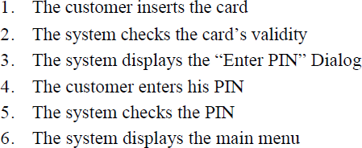
Scenario Testing – Example 2
We are developing ATM for Allied Bank of Pakistan
One scenario is authentication

Slide 30
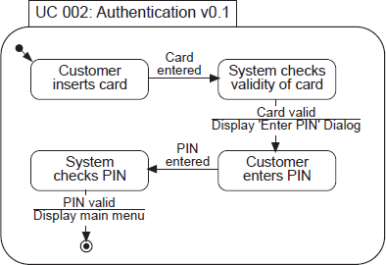
Scenario Testing – Example 2 (Contd.)
State Chart view of the system

Slide 31
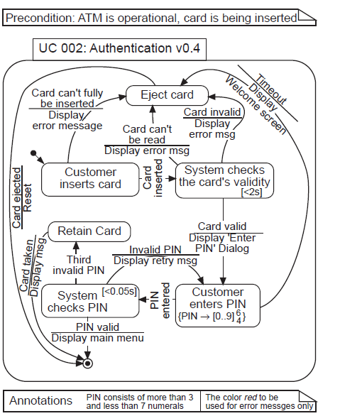
Scenario Testing – Example 2 (Contd.)
State Chart view with alternative flows

Slide 32
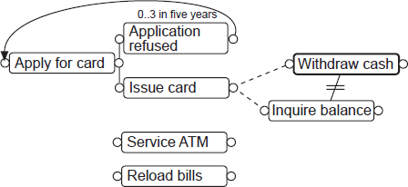
Scenario Testing – Example 2 (Contd.)
Dependency chart of the system

Slide 33
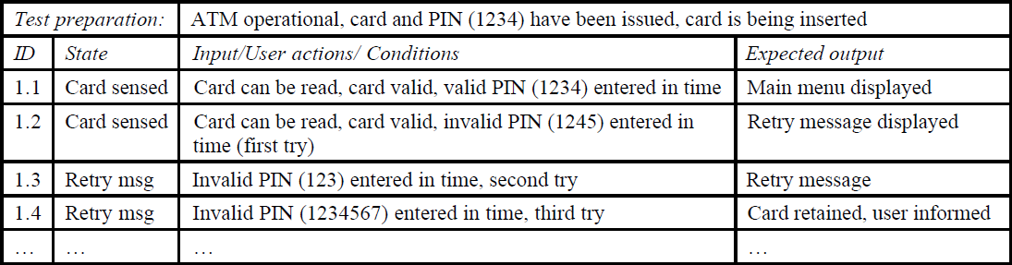
Scenario Testing – Example 2 (Contd.)
We can derive test cases
From state chart (we already know)
From dependency chart ?
Written at the time of requirements elicitation

Slide 34
Conclusion
Scenarios can be viewed differently from:
System’s usage perspective
Usability perspective
Functionality validation perspective
It is important to find out what you are planning to conduct or perform
Next week, we look into:
Test cases development purely from use case diagram
test cases development from usability point-of- view

